Slide 1
Image Matching System
group15
Xiaoqing Geng: 5140309383
Rulin Huang : 5140379001
Chao Gao : 5142029014

Slide 2
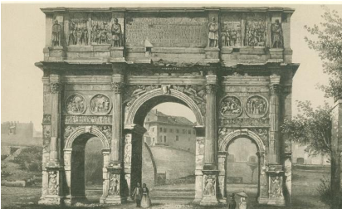
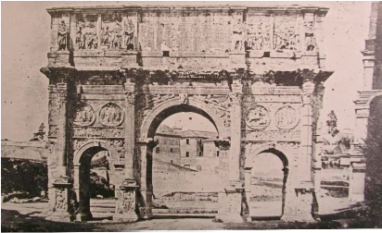
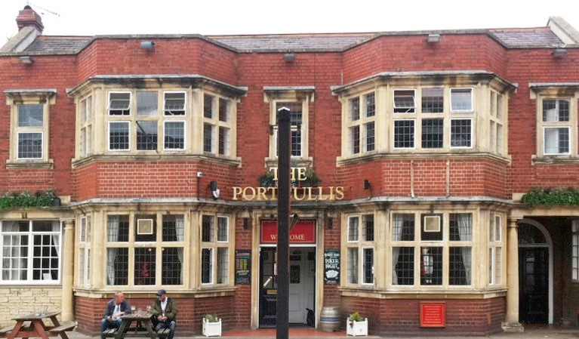
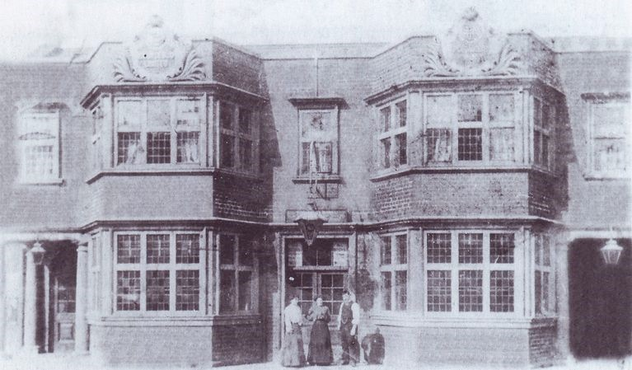
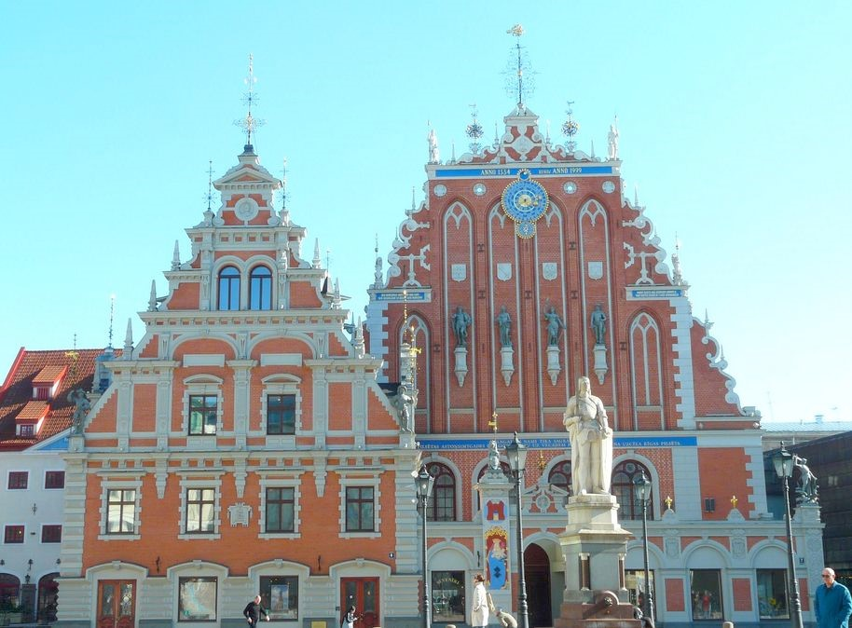
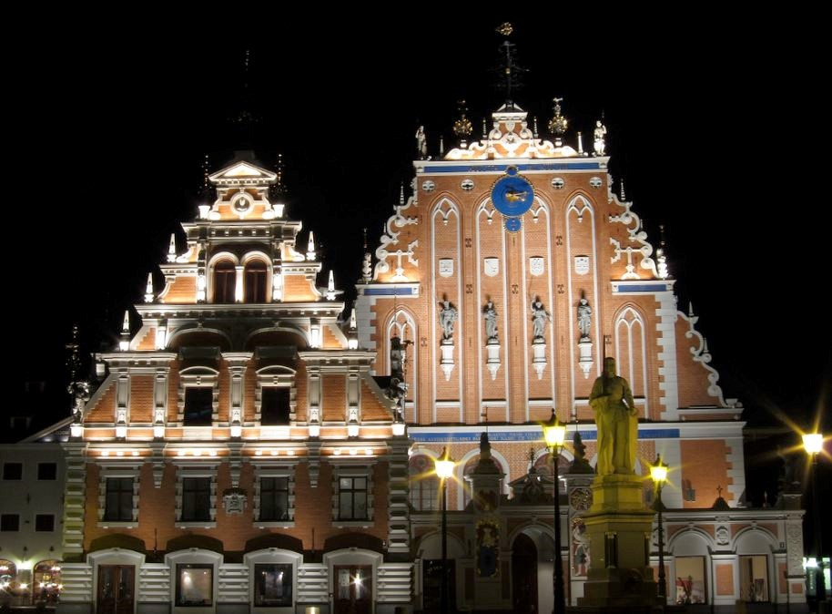
Problem Definition
Goal:
extracting local features from images of architectural scenes, based on detecting and representing local symmetries.
Notes:
The technique for extracting local features from images of architectural scenes, based on detecting and representing local symmetries. These new features are motivated by the fact that local symmetries, at different scales, are a fundamental characteristic of many urban images, and are potentially more invariant to large appearance changes than lower-level features such as SIFT.
我们希望获得结果是：
能够对图象进行具象化的匹配
增加准确度
显示准确率
如何去做
调整当前的算法
将原有的方式移植到c++平台，从而更方便的调用opencv的库函数进行特征值的显示工作
在原有论文的基础上，改变匹配的方式

Slide 3
Paper’s Approach
local bilateral and rotational symmetries
For a range of dramatic variations in lighting, age, and rendering style
feature detection: finding local maximum of the scores
feature description: building a feature vector from local symmetry scores
Notes:
The closest work to the original one is probably the selfsimilarity descriptor of Shechtman and Irani
In their case,they use a variety of symmetries, rather than repetitions, as cues , and use these to define both a feature detector and a descriptor
In contrast, the paper do not make hard decisions about symmetric structures, but instead compute many local features based on a softer definition of a symmetry score.

Slide 4
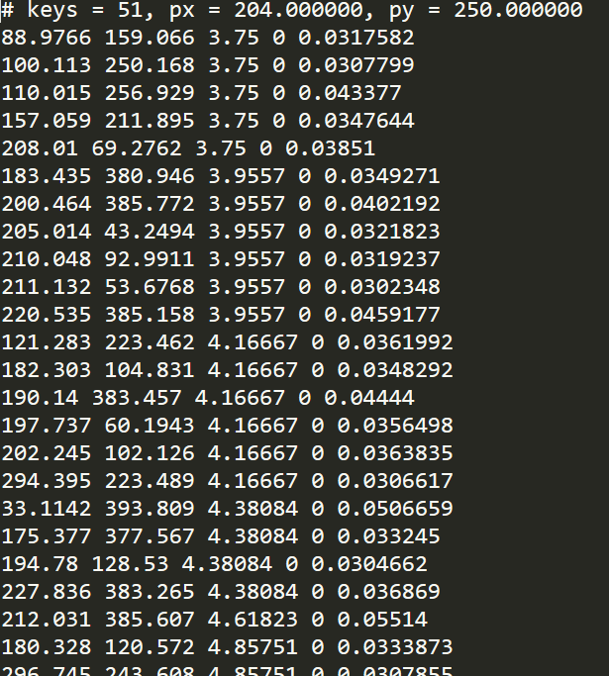
Proposed Idea
Based on the original algorithm then Improve it
Improved the Direction detection
Add the accuracy display
Add the patch matching
Notes:
However when we overview the original code we find that there is a bug here that if we have a look at the features the code generated
We will find that the forth column are all zero which means that the orientation have no meanings here.
So we change the code platform from matlab to c++ in order to take it easy to change the code and use the oepncv lib to make some work simple . Like draw the features using the built-in function and draw the line between the two pics based on the features value.
So we impove the original method in these four aspects.
设计思想是：
算法：增加横纵的特征值匹配
Match
symmetry test
virtual test
针对原有图象的提取特征值的方式
进行图象的归类
对样本进行测试

Slide 5
Implementation Detail
Algorithm:
horizontal, vertical symmetries
Create a matrix of Pic A to B’s features
Direction detection:
Avoid the Reverse direction matching(take location into consideration)
Notes:
Algorithm:
We added the original paper based on the horizontal and vertical symmetry detection. Because most of the buildings are in the horizontal and vertical direction has a great characteristic.
For the feature points extracted in the image A, we set up the corresponding values for each feature point in B. The smaller the Euclidean distance, the higher their similarity.
The higher the ratio between the matching point and the second matching point, the better the matching.
On the basis of the original, we also added a directional detection function.
That is, the points located at the top are not matched with the points located at the bottom to ensure that the relative position of the matching is fixed, thus avoiding the nonsense matching of the feature points which causing the wrong matching.
我们在原有论文基础上增添了水平垂直的对称性检测。因为大部分的建筑都在水平和垂直方向有很大的特征性。
针对在图片A中提取到的特征点，我们在B中建立每一个特征点与之相对应的值。欧式距离的值越小说明他们的相似性越高。
当与之匹配的点和第二与之匹配点的数值之比越高，也就说明匹配性越好。
在原有的基础上，我们还增添了方向性检测的功能。
也就是位于上方的点尽量不和位于下方的点进行匹配，以确保匹配的相对位置是一定的，避免特征点无意义匹配，造成错误的匹配。

Slide 6
Implementation Detail
Add the accuracy display:
the original paper only show the current picture’s features
Calculate the feature matching numbers
Add the Patch matching:
Strengthen the feature matching
Notes:
原有的论文 generate two sets of perfectly matched synthetic detections by creating a set For each pair of images we extract keypoints and descriptors and match descriptors using the standard ratio test。
The original algorithm can only calculate the weight of each feature point for the surrounding feature points, and then compare the weight of the surrounding feature points with the feature points of the other map.
We are based on the original, calculated in line with a certain value of the matching points of the total number of the proportion of the total, or the number of these constant value of certain requirements. Can be considered to meet the requirements of the match.
At the same time the original algorithm has great limitations, so we have increased the batch processing system, which can be completed at one time on a map and other maps of all the comparison.
原有的算法只能计算每一个特征点对于周围特征点的权值，然后在对周围特征点权值的比重上和另一张图的特征点进行比较。
我们则是在原有基础上，计算在符合一定匹配值的特征点的数量占总量的比重，或者是这些特恒值的数量一定要求。即可算是符合匹配的要求。
同时原有的算法方式有着很大的局限性，因此我们增加了批量处理系统，从而能够一次性完成对一张图和其他图的所有比较。

Slide 7
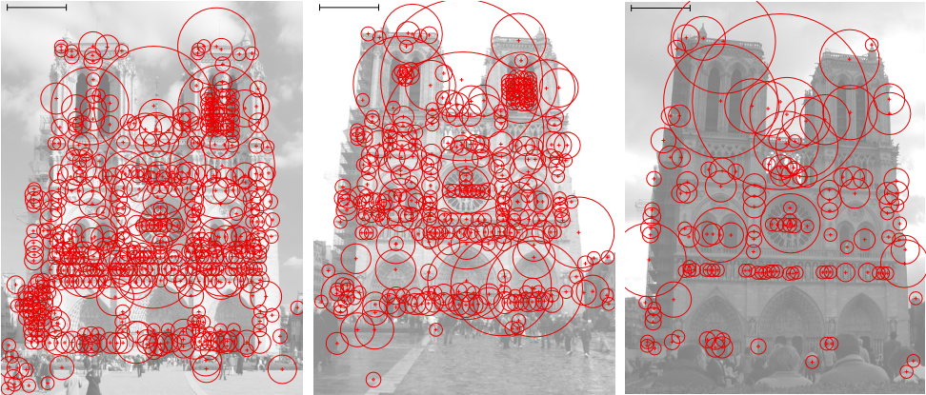
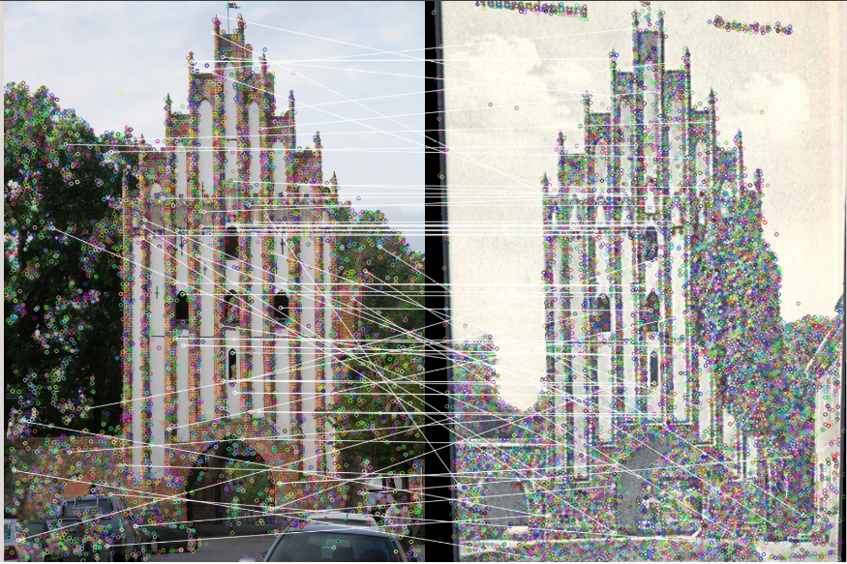
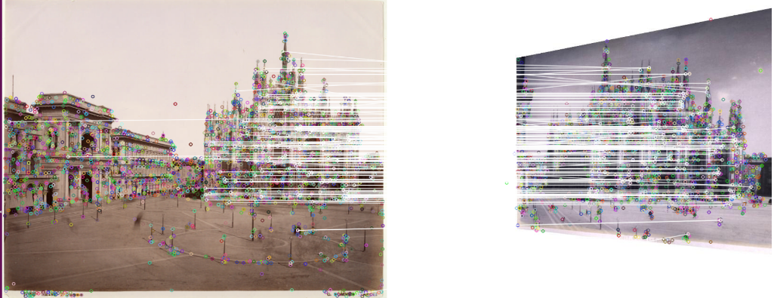
Experimental results
Original :
Now :
Notes:
展示以下测试的结果
The following is a comparison of the results.
This is the original algorithm to generate the image, we can see that it only corresponds to the surrounding pixels through the circle size display weight.But in our improvement, we can clearly see the current can be directed against two different images directly feature point matching. Through the intuitive connection to the more concrete point of view.
这是原来的算法生成的图象，我们可以看到它只有对应周围像素点通过圆圈的大小显示权值。
但是在我们改进，我们可以清楚地看到当前可以针对两张不同的图象直接进行特征点的匹配工作。通过直观的连线让特征点的比较具象化。

Slide 8
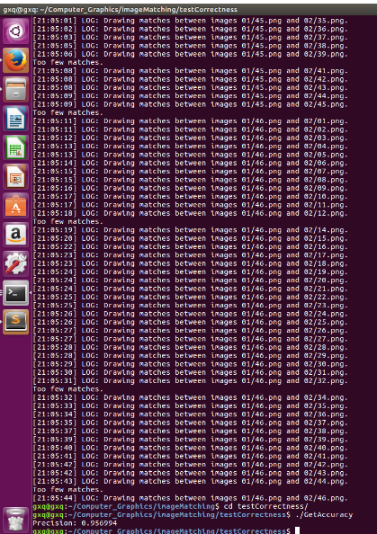
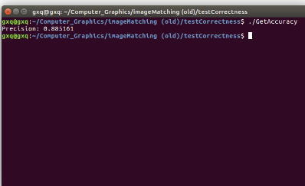
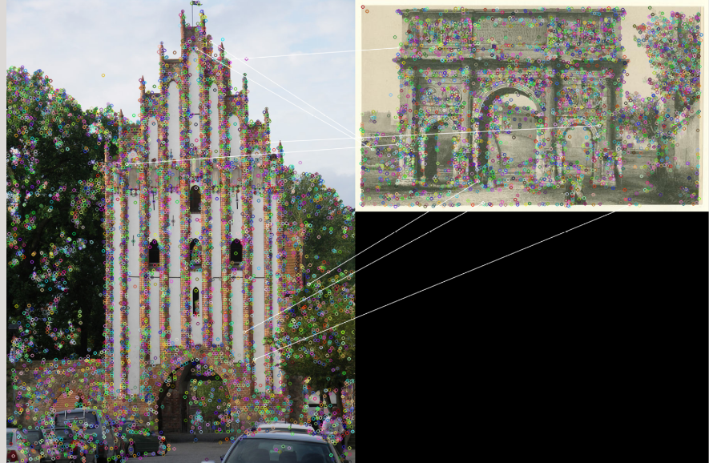
Experimental results
Not matching pic
Batch processing
Accuracy number
Notes:
The first picture shows the two maps can not match the situation.
The second picture shows the batch processing situation.
The third figure shows our figurative accuracy.
第一张图展示了不能match的两张图的情况。
第二张图展示了批量处理的情况。
第三张图展示了我们具象化精确度的情况。

Slide 9
Conclusion and Future Work
From matlab to c++
Improve the algorithm of matching
Support patch matching
Add the accuracy number
We have done
We can still do
Shorten time latency
add the friendly interface
Notes:
So there is much future work to do

Slide 10
References
[1] Daniel Cabrini Hauagge and Noah Snavely. Image Matching using Local Symmetry Features. Cornel l University, 2012
[2] P.Kovesi. Symmetry and asymmetry from local phase. Australian Joint Conf. on Artificial Intelligence, 1997.2.
[3] P.Kovesi. Image features from phase congruency. Videre: Journal of Computer Vision Research, 1992.2
[4] Y.Liu, H. Hel-Or, C. Kaplan, and L. V. Gool. Computational Symmetry in Computer Vision and Computer Graphics. Foundations and Trends in Computer Graphics and Vision, 2009.2

Slide 11
Thank you

